Slide 1
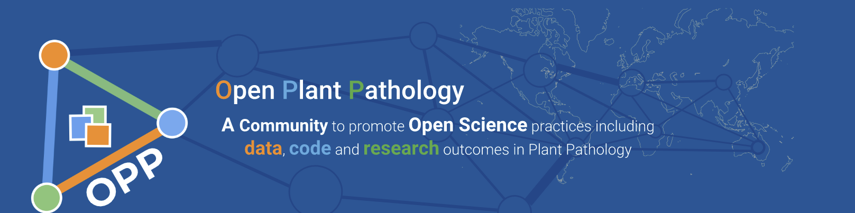
Things’ll aye be some way
Neil McRoberts, University of California, Davis
Gareth Hughes, SRUC, Edinburgh, UK
https://openplantpathology.netlify.com/
https://communityinviter.com/apps/openplantpathology/open-plant-pathology
Support for NMcR comes from USDA NIFA Hatch Project No. CA-D-PPA-2131-H

Slide 2
Outline
Is repeatability over-rated?
From a Bayesian perspective repeating the same experiment provides declining support for an hypothesis - should we place more emphasis on alternative, supporting experiments that provide different evidence?
Why do we think we have a repeatability crisis?
What is the replicability crisis narrative?
What is it that we want to repeat?/what should biological observations look like?
Variance is information
What are biological observations made from?
Nothing changes, nothing is the same

Slide 3
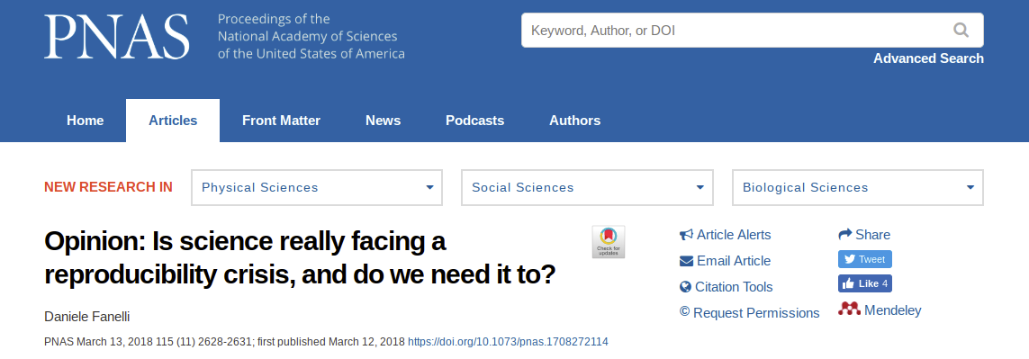
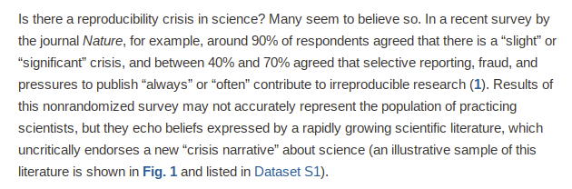
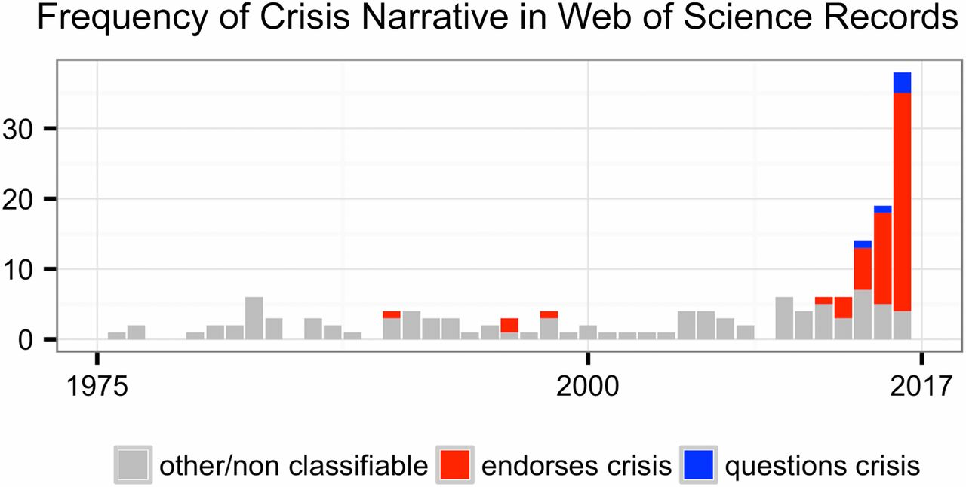
The crisis narrative
Notes:
Collective belief that there is a crisis is one of our best defences against it. That is, if we all believe that there’s a crisis then we’ll take action (such as this workshop) to avert the crisis.

Slide 4
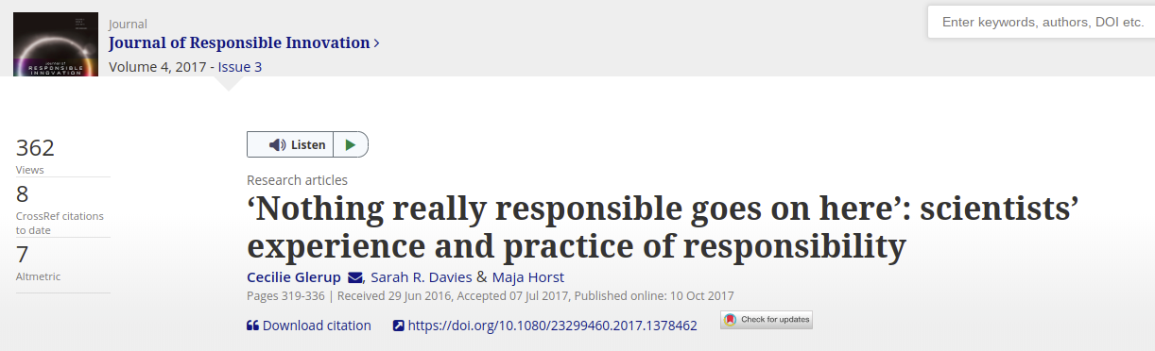

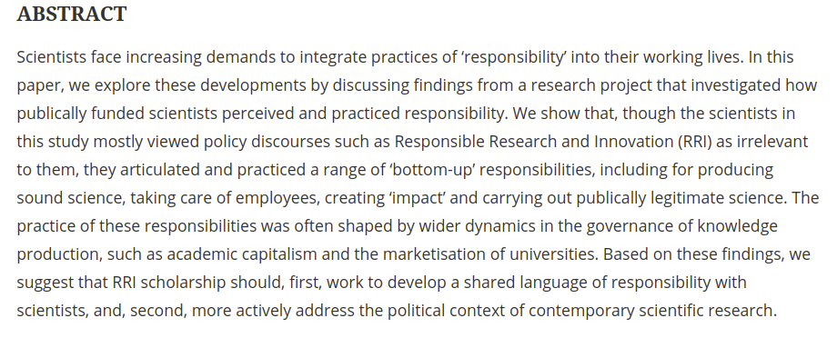
We’re pretty good at being good
Scientist, Tamara de Lempicka

Slide 5
If not lack of RRP and growth of QRP, what’s the problem?
Propositions:
We don’t understand variance
We don’t understand the relationships among three important abstractions: probability, information, and variance
We have unreasonable expectations about the replicability of biology
We teach a “lies to children” version of biology that focuses too much on rules and largely ignores stochasticity

Slide 6



Variance: why it’s not your enemy
Variance is: the expectation of squared deviation of a random variable from its mean
Information entropy (Shannon) is the average rate at which information is generated from a random source
If the squared deviations from the mean can be thought of as a probability distribution, comparison with the Shannon equation shows that the variance of a random variable is an information quantity
Time for some coding theory
Assign each value of a codeword of length l_{i} using an alphabet with r symbols, then the Kraft inequality states In; in other words, a probability distribution is a codelength function and vice versa The deviations in the variance contains (in the technical sense) the information about the location of the observations in relation to their mean
Notes:
Note the structural similarity between the equations describing the variance of a random variable and the Shannon entropy. The quantity for which the expectation is being calculated differs between the two quantities, but the structures are the same.

Slide 7

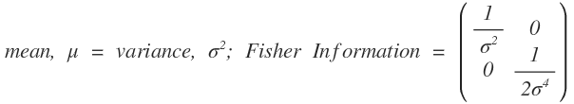
More on information, probability and variance
Poisson Distribution (small counts - discrete, bounded by 0)
Beta Distribution (proportions, continuous, bounded between 0 and 1)
Normal Distribution (continuous, finite variance, effectively unbounded)
For more on relationship between Fisher Information and Shannon information see: Wei, X-X & Stocker, A. A. 2016. Mutual Information, Fisher Information, and Efficient Coding. Neural Computation, 28: 305-326
Notes:
The mathematical notation is only presented to show that a term for the variance appears in every case of the definition of the Fisher Information for random variables. The relationships between Fisher’s measure of information and ones developed from Shannon’s ideas are subtle and rather complex, but the important point is that there is an equivalence so that it’s possible to say in general terms that Fisher Information does indeed quantity the same sort of thing that Shannon information measures.

Slide 8

Biology: a blend of rules and noise endlessly looking for optima
Rules: Population value is dependent of values in two previous generations (time steps), plus a constant.
Noise: What it the values of the parameters are time-varying random variables?
What are the implications for replicability if the
Intrinsic dynamics show this pattern?
How many different kinds of behavior can this model exhibit?
Y_{t}
?
time, t
Notes:
So, having laid out the idea that variance and information are intimately connected, the point of the last couple of slides is to look at a specific example of the way that noise combines with rules to produce dynamic behaviour in biology in a way that might make us be more realistic in our expectations of repeatability

Slide 9
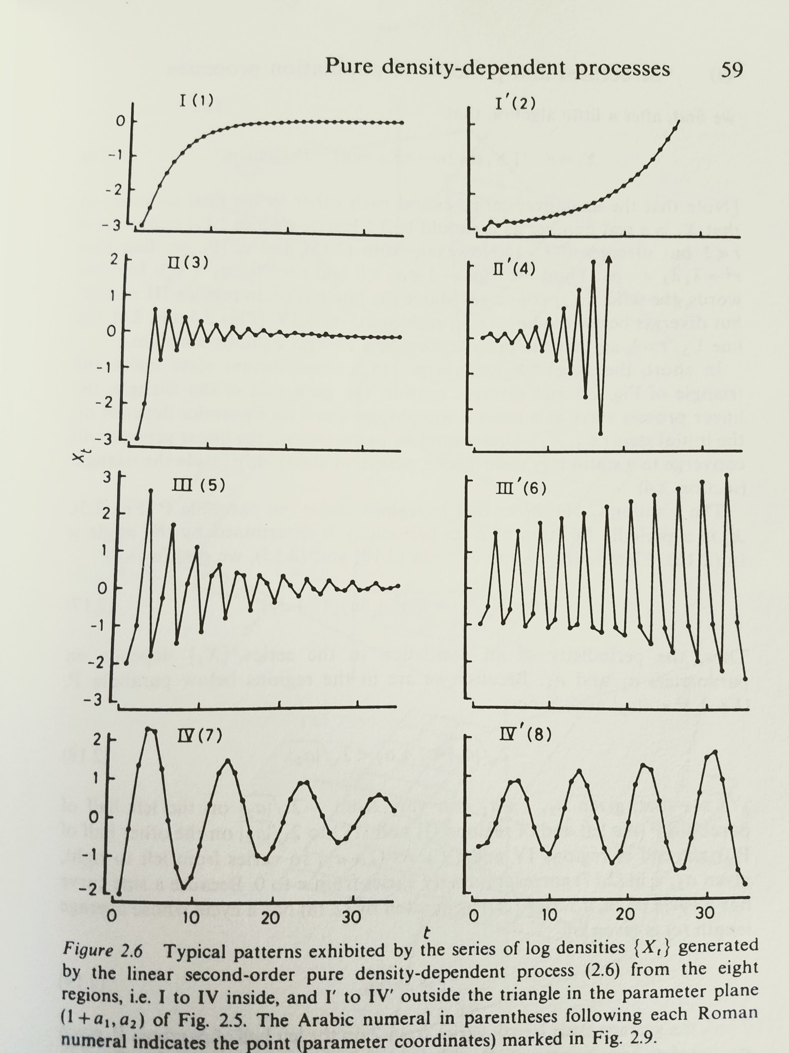
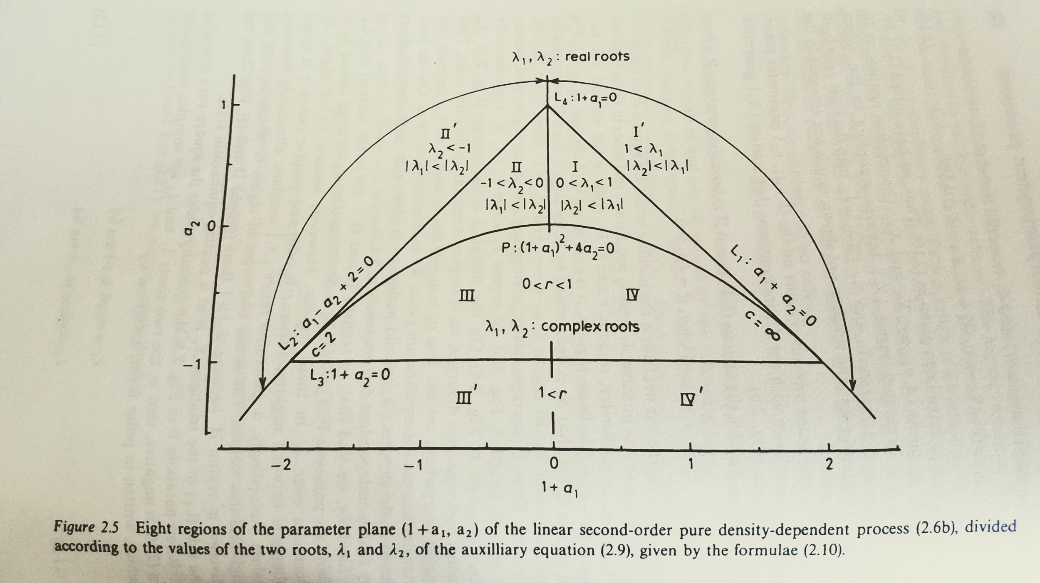
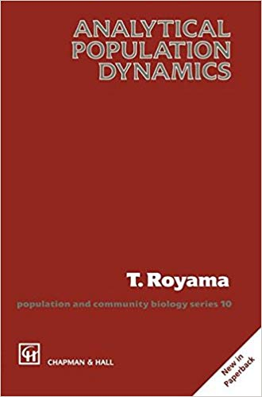

Variation possible with simple rules and no noise
Notes:
There are several important points to take from this slide. First the equations. The upper one is the auxillary equation for the equation expressing the lagged population density. When the auxillry equation is solved it generates posiitive and negative solutions with roots lambda_1 and lambda_2. With those values in hand, we can write a general solution for the time evolution of the population value in terms of the roots and the first difference in system values - this is shown in the lower equation. The derivation of these equations is given in Chapter 2 of Royama’s book.
The figures. The point of the figures is to show that the simple model in which the currrent state of the system is determined only by the previous two values, is capable of a wide variety of dynamic behaviours even with out adding noise. Each time plot (on the left) corresponds to a single point in the parameter space (on the right). Th Roman numerals show the regions of the parameter space corresponding to the different time plots

Slide 10
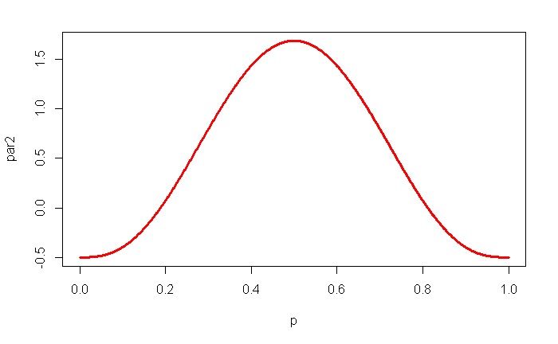
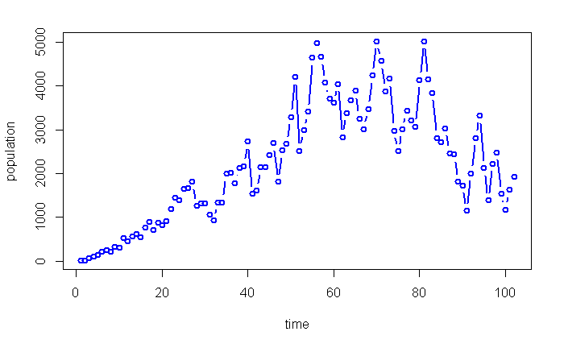
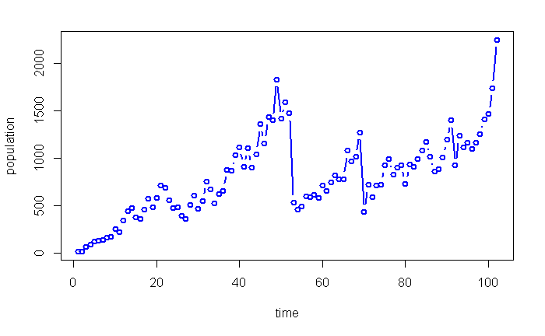
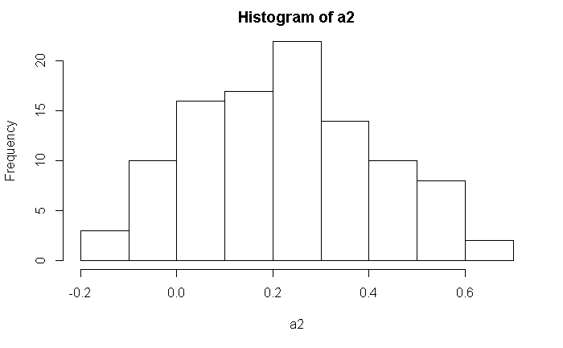
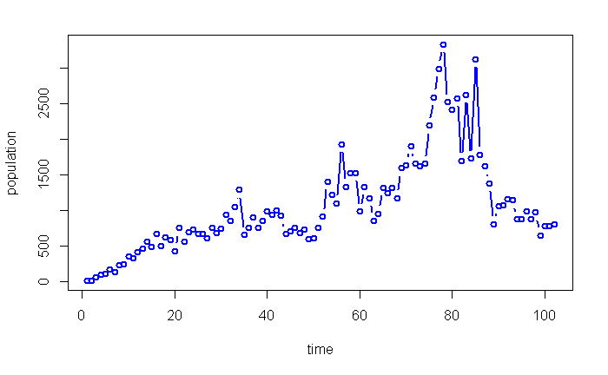
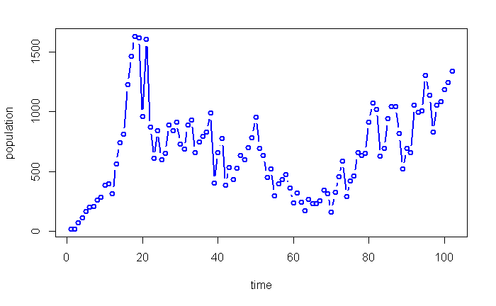
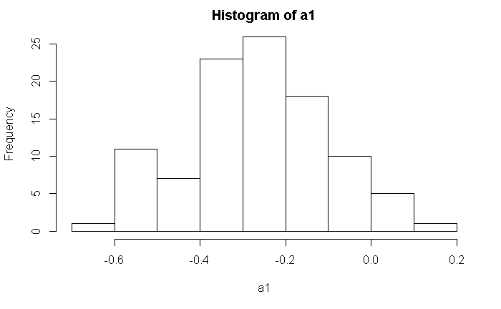
Mixing rules and noise
Parameters a₁ and a₂ now random variables based on Beta distribution Be(4,4)
Notes:
We add noise to the equation by drawing random numbers from beta distributions centered on 0.5 and adding different constants to the random component when larger shifts are needed. The four time plots are simply four random replicates obtained from running the model. Now, consider a scenario in which one of these time plots represents the observations on the level of disease of a new invasive disease each year. Initially in all series successive typical 3 to 4 year experimental studies would show some repeatability in that disease appears to increase steadily. However in all series sometime around 20 years into the series, the observed dynamics become much less predictable and successive short-term studies would find it very difficult to replicate each other. Remember nothing about the system is changing: the rules are the same, and the source of the noise is the same throughout, but the behviour of the system is complex and not easy to infer from short run samples.

Slide 11
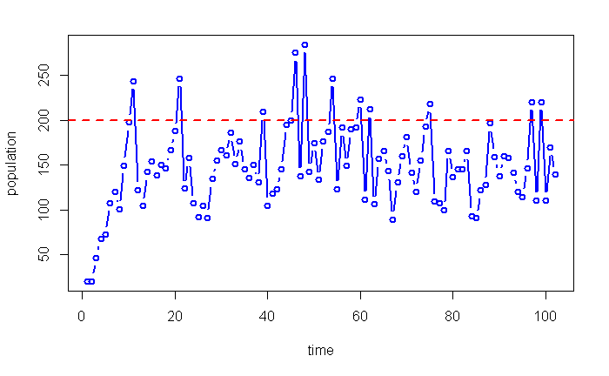
Adding more rules doesn’t help
Applying thresholding rules can induce chaos
Notes:
Of course, we often would not simply stand back and watch the dynamics, we might attempt to intervene, perhaps by using a threshold approach and applying control when disease exceeds a pre-defined level. The final slide shows one simulation output in which the intrinsic dynamics are the same as shown in the previous examples, but control is applied (reducing the population by a fixed proportion) if the disease exceeds a known value. It has been known for some time (although it is not widely appreciated) that this kind of thing can induce chaos in the dynamics

